Slide 1
How to apply for an Erasmus+ Mobility: a step by step guide

Slide 2
Welcome!
This is a step-by-step guide for students to ensure that you apply for an Erasmus+ mobility successfully .

Slide 3
All information and calls for Erasmus+ mobilities are published on the College and mobility websites: www.vts.su.ac.rs and https://www.vts.su.ac.rs/mobility-news

Slide 4
International Office
All Erasmus+ mobilities and applications are handled by the International Office (Office 109)
Erasmus coordinator:
Livia Szedmina, PhD + team
https://www.vts.su.ac.rs/mobility-contact
mobility@vts.su.ac.rs
slivia@vts.su.ac.rs

Slide 5
This guide will give you useful tips:
for writing effective CVs and motivation letter,
how to get letters of recommendation and transcripts of grades,
how to fill in a Learning Agreement,
how to improve your English language skills,
final check list of documents

Slide 6
Want to apply for a mobility? What documents do you need?

Slide 7
1.
CV (Curriculum Vitae)

Slide 8
CV (Curriculum Vitae)
one of the basic documents for a scholarship
Note: there is no one correct way to write a CV, but here tips to make your CV better
use the European CV format, e.g. EuropassCV
provide all relevant information regarding education, work experience, volunteer and extracurricular activities
list your skills

Slide 9
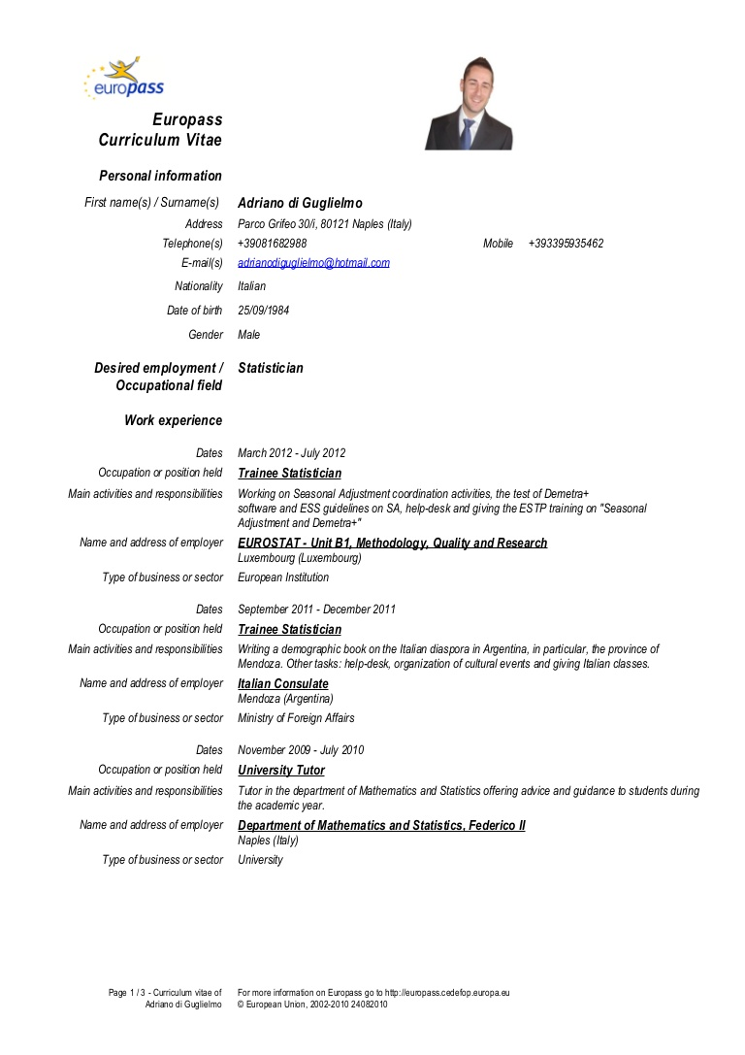
CV
Here is a standard CV format
https://europass.cedefop.europa.eu/
Place your screenshot here

Slide 10
2.
Motivation letter

Slide 11
Motivation letter tips – 1:
not be longer than one A4 page
precise, understandable and logical language
spellcheck!!!
include: who you are, what you can do and what you want to achieve
why you are applying for this mobility programme

Slide 12
Motivation letter tips – 2:
what benefits you will have from this programme
what you can learn at that particular university you are applying to
Overall goal:
present yourself as a rational, optimistic and motivated person who is ready to learn and improve

Slide 13
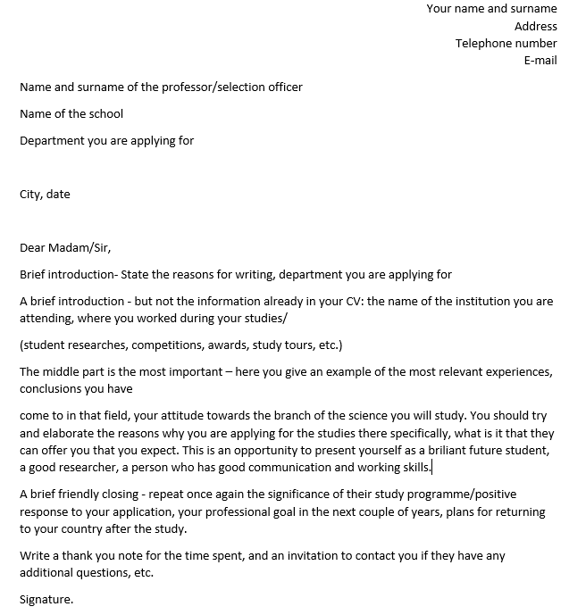
Motivation letter sample:

Slide 14
Useful links for motivation letter:
https://www.cscscholarship.org/motivation-letter.html
https://novoresume.com/career-blog/how-to-write-a-motivation-letter
https://www.mastersavenue.com/articles-guides/how-to-get-in/motivational-letter
http://ic.daad.de/imperia/md/content/islamabad/letter_of_motivation.pdf

Slide 15
3.
Letter of recommendation

Slide 16
Letter of recommendation tips – 1:
presents a complete picture of you and your qualifications
written by one of your professors
detailing your academic qualities, leadership abilities and commitment to the community
aim is to provide information about your knowledge, capabilities, activities, working habits, personal characteristics.

Slide 17
Letter of recommendation tips – 2:
If you yourself are writing a letter of recommendation:
be precise: name, title and position of the person recommending you.
put in their contact information
mention how long this person knows you, what kind of cooperation you have had (student-professor, working on joint research…)
Important: show the letter to the person in whose name you wrote it and who will sign it.

Slide 18
4.
Transcript of records (grades)

Slide 19
Why do you need a transcript of records?
gives you – and your College – accurate and updated assessments of your progress
Includes:
number of ECTS credits achieved and grades awarded
provides evidence of success and recognitions

Slide 20
Who issues a transcript of records?
official document
First – issued by home institution
sent to the host institution
providing information on the educational already components completed
Next - host institution issues transcript of the grades achieved during mobility
Confirmation for the results of studying abroad

Slide 21
5.
Learning Agreement

Slide 22
Includes:
a list of courses, modules, subjects you are planning to attend at another institution
the number of ECTS credits for each subject
has to be signed by the home institution (Subotica Tech), host-institution and you, the student
shows correspondence between courses completed during mobility and courses to be recognized at home institution

Slide 23
Why do you need this?
Guarantee for recognition of study programmes at the host institution
Download the standard Learning Agreement here:
https://ec.europa.eu/programmes/erasmus-plus/resources/documents/applicants/learning-agreement_en

Slide 24
6.
Foreign Language Certificate

Slide 25
Confirming you knowledge of English
Are you good at English? Great! Show us!
Get good grades at the English subjects in our curriculum at Subotica Tech
Present a language certificate
Use the Online Linguistic Support (OLS)

Slide 26
What is the Online Linguistic Support?
Designed to assist Erasmus+ participants in improving their English knowledge.
Link to Online Linguistic Support (OLS):
https://ec.europa.eu/programmes/erasmus-plus/resources/online-linguistic-support_en

Slide 27
Improve your English! Take a language course!
Subotica Tech organizes English language courses for improving English skills
When: the course usually starts in the first or second week of the semester
More information: International Office (Office 109)

Slide 28
Language course in Serbian
Subotica Tech also organizes Serbian language courses
aimed at both incoming and outgoing students
When: the course usually starts at the first or second week of the semester
More information: International Office (Office 109)

Slide 29
You’re almost there…
Three
Two
One

Slide 30
7.
Final checklist

Slide 31
Check if Subotica Tech has a signed Inter-Institutional Agreement with the institution of your choice
Your Erasmus mobility could be here
Or here
Or here

Slide 32
FINAL CHECKLIST – 1
search through the College's website or contact the International Office for available mobilities
make sure you are eligible for applying
mind the deadlines!
analyse the host institution you want to apply at and find your field of study
find out about the application process
collect all the necessary documents

Slide 33
FINAL CHECKLIST – 2
run a spell check and grammar check - yes, this is important
make sure all the documents are signed
send documents in PDF format
keep the originals, you will need them if you get a positive answer
find someone who will check all the documents again
send your application with all necessary documents

Slide 34
8.
Make the most of your mobility!
This is an excellent learning opportunity, use it!

Slide 35
Good luck with your mobility application!

